Slide 1
Analyzing different models for Intrusion Detection Systems
Team Members
Manivannan N – 24m0796
Kartik patel – 24m0777
Ishan Chandra – 24m2103

Slide 2
We are comparing the below models for the intrusion detection system on the KDD dataset.
Decision Tree
Random Forest
Logistic Regression
SVM
Neural Network
Transformer
Link for the dataset:
https://www.kaggle.com/datasets/hassan06/nslkdd?select=KDDTrain%2B.txt

Slide 3
Decision Tree
Highlights:
We have created the Decision tree classifier for the multiclass classification from scratch.
The class takes maximum depth and minimum samples needed to split as an argument.
We are determining the best split using information gain.
Splitting recursively until any of the conditions are met.
Marking the leaf as a label with higher counts in that leaf.
During prediction, we are just traversing the nodes based on the splitting criteria decided during training and predicting based on the reached leaf’s label.
Also used boosting with the help of sklearn library.

Slide 4
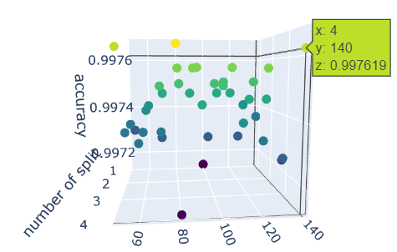
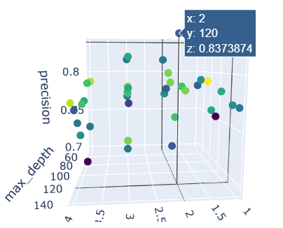
Best Scores for the model
Accuracy: 0.997
Precision: 0.789
Recall: 0.857
F1 score: 0.773
Top 5 important features for the model
dst_bytes
src_bytes
dst_host_count
dst_host_srv_count
count
Highly sensitive features for this model: (features which change a lot for small perturbations in the data)
service_ecr_i
src_bytes
Accuracy wrt min samples and max depth
Precision wrt minimum samples and max depth
Best scores using Adaboost
Classifier (from sklearn)
Accuracy: 0.997
Precision: 0.805
Recall: 0.916
F1 score: 0.784

Slide 5
Random Forest
Highlights
We have created the Random Forest classifier from the scratch using Decision Tree class which we have created.
The class takes number of trees, maximum depth and minimum samples needed to split as an argument.
For each tree, we are using whole shuffled data as we have less data.
During prediction, the label which is returned more common is returned.
As the Data is not balanced, use a balanced random forest model from imblearn.

Slide 6
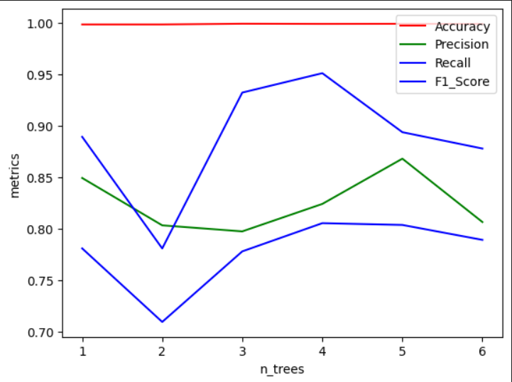
Best Scores for the model
Accuracy: 0.997
Precision: 0.830
Recall: 0.789
F1 score : 0.709
Top 5 important features for the model
dst_bytes
src_bytes
dst_host_count
dst_host_srv_count
count
Highly sensitive features for this model:
(features which change a lot for small perturbations in the data)
service_ecr_i
Flag_SF
Metrics wrt number of trees and same best tree parameter as of the DT
Best scores using balancedRandomForestClassifier (using imblearn library)
Accuracy: 0.766
Precision: 0.754
Recall: 0.333
F1 score: 0.366

Slide 7
PCA
Highlights
We have implemented the PCA from scratch to check the variation of the features.
Problems faced
The standard approach of finding the eigenvector from the covariance matrix didn’t work in our systems because the covariance matrix needs 150000 x 150000 matrix, which is nearly impossible for the machine to allocate that huge memory (120GB).
So we used X^{T} X and found the eigenvectors from ( X * eigenvectors of X^{T} X ).
Top features with high variation
Duration
Protocol_type
Service

Slide 8
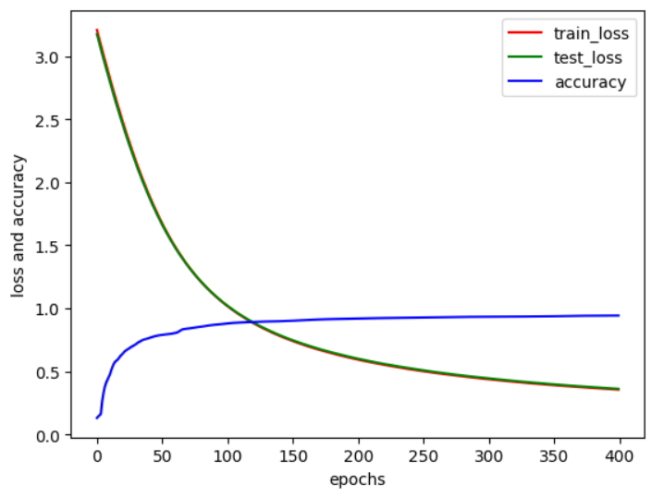
Logistic Regression
Highlights
Used pytorch for the Logistic Regression implementation
Loss function – cross-entropy loss
Also used Boosting for Logistic regression with the help of sklearn library.
Losses and accuracy wrt epochs
Metrics at 300 epochs
Accuracy: 0.9523
Precision: 0.508
Recall: 0.347
F1 score: 0.337
Metrics using boosting
Accuracy: 0.938
Precision: 0.472
Recall: 0.460
F1 score: 0.404

Slide 9
SVM
Highlights
We have implemented SVM from scratch for multiclass classification.
Minimized the soft margin optimization function using gradient descent.
Used one vs rest technique for implementing multiclass classification.
During prediction, returning the class with the highest probability.
The standard approach of implementing kernel trick from scratch won’t work in our systems because the matrix of size 150000 x 150000 is needed; it is nearly impossible for the machine to allocate that huge memory (120GB).
So we have implemented the kernel trick using sklearn library.

Slide 10
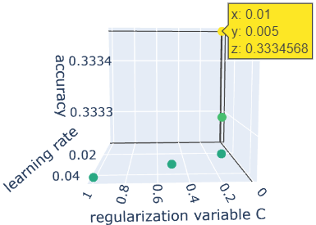
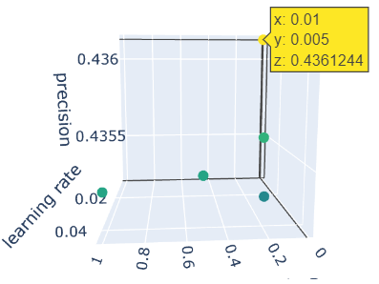
Accuracy wrt learning rate and regularization variable
precision wrt learning rate and regularization variable
Best scores using vanilla SVM
Accuracy: 0.333
Precision: 0.436
Best scores using kernel trick with the help of sklearn library
Accuracy: 0.996
Precision: 0.846

